Slide 1
WHAMP: Year 1 Progress report
Washington HIV/AIDS Modeling for Prevention
Martina Morris, PhD
Departments of Statistics and Sociology
University of Washington
UW Network Modeling Group

Slide 2
Project collaborators
Modelers
UW
Martina Morris, PhD
Darcy Rao, Deven Hamilton, Jeanette Birnbaum
University of Minnesota
Eva Enns, PhD
Caleb Easterly, Zoe Kao
Emory University
Sam Jenness, PhD
Kevin Weiss
Epidemiologists
WADOH staff
Tom Jaenicke
Jonathan Downs

Slide 3
Project goals
Build a WA State HIV/AIDS projection model
Focus on the MSM epidemic
State specific: model structure and data inputs
Study the impact of different State investment strategies
HIV incidence and prevalence
Cost per case averted
Optimal investment strategy

Slide 4
Outline
History and Context
Model Development
HIV Transmission and Care Engagement
Economic Investments and Impacts
New data collection: WHAMP survey
Discussion

Slide 5
History and Context
Applied Modeling for Prevention Projects
Modeling software development

Slide 6
WHAMP and its relatives
CAMP: Coalition for Applied Modeling for Prevention
MSM
CDC Project: 2015-19
SHAMP:
Seattle Heterosexual
NIH R21: 2016-19
WHAMP:
Washington State
UW CFAR SPRC: 2015-2017
Darcy’s PhD
PrEP Intervention
CFAS Fellowship: 2015-18
WADOH Project
WA MSM
WADOH Contract: 2018-20

Slide 7
In addition: Model Infrastructure Support
Software package development (open-source, free)
20 years of NIH support (M Morris PI)
statnet: Statistical models for network analysis and simulation
EpiModel 1.0: Modeling epidemics on networks
Current support: MIDAS (NIH R01, S Jenness PI)
EpiModel 2.0

Slide 8
Network modeling for epidemics
Relies on statistical methods
For dynamic network estimation and simulation
Exponential family Random Graph Models (ERGMs)
Designed to use very simple network data
“Egocentric” sampled network data
Implemented like a traditional cross sectional sample survey
We’re teaching our weeklong workshop in August…

Slide 9
Model development (I)
HIV Transmission and Care Engagement

Slide 10
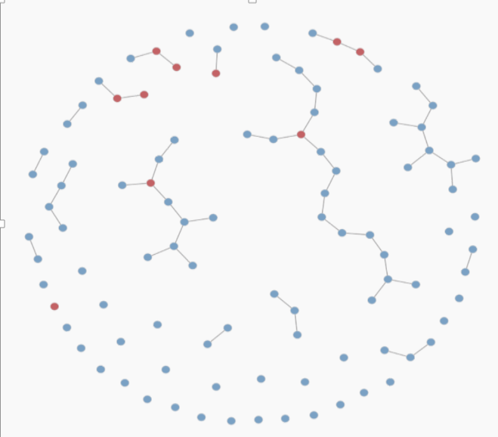
Key components of the framework
Dynamic partnership network: Main, Persistent and 1-time
Transmission:
Behavior
Coital Frequency
Condom Use
Infectivity, by
Stage
CC engagement
Clinical outcome
Care Engagement:
Behavior
Testing
PrEP or ART dynamics
Economics
Eligibility (Insurance. and DAPs)
Uptake/Adherence
Cost by component
Demographics:
Entry
Aging
Exit

Slide 11
What makes the model WA specific?
Model Structure
Regional heterogeneity (Sexual networks, CC engagement)
King Co, Other Eastern WA, Western WA
Policy levers
Insurance and DAPs
Data Inputs
Demographics
Sexual behavior and networks
Care engagement and outcome
Costs

Slide 12
Overview: Transmission model components
Component | Features and processes
Demographics | Population composition by key attributes, births, aging, deaths, circumcision
Network | Degree, Duration, mixing
Behavior | HIV status disclosure, condom use, coital frequency, sex role
Intrahost epidemiology | Natural progression of HIV, modeled as viral load progression
Clinical epidemiology | Testing, ART initiation, ART cessation, ART reinitiation, viral suppression
Transmission | Within discordant dyads, dependent on viral load, AI frequency, condom use, CCR5-Δ32 allele, circumcision
Interventions | PrEP, ART and DAPs
Will discuss the status of each of these in turn

Slide 13
Demographics: Region
3 Regions
Sources:
2011-2015 American Community Survey 5-year Estimates for WA males
Weighted by estimated proportion of males who are MSM in each region from Grey et al. (2016)
57.1%
32.8%
10.1%
King County
Other western
WA
Eastern WA
Grey et al. (2016). JMIR Public Health Surveill, 2(1), e14. doi:10.2196/publichealth.5365

Slide 14
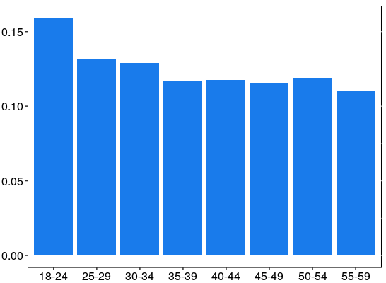
Demographics: Age
Age: 15-??
Darcy’s PhD: 15-59
Sources:
2011-2015 American Community Survey 5-year Estimates for WA males by region
Weighted by estimated size of the MSM population in each region
Proportion
Assumptions:
The age distribution of MSM within each region is the same as all males
18-24
25-29
30-34
35-39
40-44
45-49
50-54
55-59
Age group
Question: HIV related health care costs for 60+yo MSM

Slide 15
Demographics: Race/Ethnicity
Collapse to 3 categories
Hispanic | 10.8%
Non-Hispanic Black | 6.1%
White | 68.0%
Asian | 10.8%
Native Hawaiian / Other Pacific Islander | 0.7%
American Indian / Alaska Native | 0.9%
Other | 2.7%
Hispanic
Black
Sources:
2011-2015 American Community Survey 5-year Estimates for WA males by region
Weighted by estimated size of the MSM population in each region
“Other”
(82%
White)
Assumptions:
The racial/ethnic distribution of MSM within each region is the same as all males
Question: Is this 3 category racial/ethnic groupings sufficient?

Slide 16
Demographics: Entry/Exit, Circumcision
Feature/process | Source(s) | Status/comments
Background mortality: Age-specific mortality rates for each racial/ethnic group | CCSR database
AIDS-associated mortality Relative increase in age-specific mortality for PLWHA | Washington State surveillance data | Thanks to Steven Erly for sharing these data!
Births New entries specified to result in a 0.75% annual growth rate | WA State OFM Forecast of the State Population, 2018 | Assume a constant growth rate to match projected 2040 population
Circumcision Percent of males circumcised by race/ethnicity | 2014 NHBS MSM4 survey

Slide 17
Sexual partnership network(s)
3 types of partnerships
“Main”
someone that you feel committed to above all others? (someone you might call your boyfriend, significant other, life partner)
“Persistent”
Not main, not one time only
“One time”
3 statistical models (for formation & dissolution)
Overlaid into one dynamic network

Slide 18
Sexual partnership network: key features
“Degree distribution”
Number of currently active partners, of each type
Heterogeneous by age, race and region
Captures concurrency (within and between partnership type)
“Mixing”
Partner attribute concordance/discordance
By age, race and region
“Partnership age”
Age of active partnerships, by type
Heterogeneous by age, race and region
Captures partnership turnover rates
Our models simulate networks that match what we observe in the data

Slide 19
Sexual partnership network: key features
Feature/process | Source(s) | Status/comments
Degree distributions | WHAMP survey | Pending data collection; will start modeling with national ART-NET data
Mixing | WHAMP survey
Partnership age | WHAMP survey
In the meantime,
We are analyzing the national ARTNET data patterns
Darcy has prototyped the statistical network models (PhD)
But based on the WA PrEP survey data + MMP and ARTNET for HIV+
Can show these results during discussion period if interested

Slide 20
Intrahost epidemiology and care cascade
Feature/process | Source(s) | Status/comments
Disease progression | Literature
HIV testing | WHAMP survey; surveillance data on late diagnoses | Pending data collection; will start modeling with national ART-NET data
ART initiation | Surveillance data | Pending decision on racial/ethnic groups and age range Thanks to Steven Erly for helping with these data requests!
Proportion that treat with full suppression | Surveillance data
Rate of ART cessation | WHAMP Survey: Calibrated to match surveillance data
Rate of ART reinitiation | WHAMP Survey: Calibrated to match surveillance data

Slide 21
HIV transmission (per act)
These parameters are not modeled as WA state specific
Feature/process | Source(s) | Status/comments
Base transmission risk for RAI and IAI and HIV+ partner at set-point VL | Literature
Relative risk of transmission by:
Viral load | Literature
Acute-stage HIV | Literature
Circumcision status | Literature
CCR5-Δ32 allele | Literature
Condom use | Literature
PrEP use | Literature

Slide 22
Darcy’s dissertation: a prototype model
Objectives:
Construct a network-based mathematical model of HIV transmission in Washington MSM
Evaluate the potential impact of PrEP on HIV incidence in Washington MSM
Network parameter estimation | Complete
Network model estimation | Complete
Epidemic model parameter estimation | Finalizing care cascade and PrEP parameters
Calibration | Feb 2019
Validation | March 2019
Analyses | April 2019

Slide 23
Model Development (II)
Economic policy options, investments, costs and impacts
Notes:
file:///F:/GitHub/SHAMP/Epidemics/scenarios/Tests/Test_Epidemic_Dynamics_NMG.html

Slide 24
Objectives
Project program sizes and costs into the future
Evaluate different impact of changes in eligibility requirements or changes in budgets / costs
Additional options
Value of information
Update them on data request

Slide 25
Update them on data request

Slide 26
EVA’s slides here

Slide 27
Individual demographics
Feature/process | Source(s) | Status/comments
Annual income | WHAMP survey | Pending data collection
Insurance | WHAMP survey
Region | WAHMP survey, WADOH claims data
 |  | Pending data collection ; waiting for claims data
Race/ethnicity | WAHMP survey, WADOH claims data
Age | WAHMP survey, WADOH claims data

Slide 28
ADAP enrollment

Slide 29
ADAP recertification

Slide 30
ADAP: parameters
Feature/process | Source(s) | Status/comments
ADAP assessment upon HIV dx or at other time | WA HIV surveillance data; assumption/calibration | (Checking with Caleb)
ADAP recertification / disenrollment | WADOH claims data | Waiting for the claims data
ADAP influences outcomes
Individuals who were not engaged in care could be in care due to ADAP | Assumptions/literature | (Not sure whether we can find the data?)
ART initiation / discontinuation / reinitiation | WADOH claims data | Waiting for the claims data
ADAP costs
Client costs | WADOH claims data | Waiting for the claims data
Assessment costs | Experts’ opinion

Slide 31
PrEP care continuum & PrEP-DAP

Slide 32
PrEP-DAP: parameters
Feature/process | Source(s) | Status/comments
PrEP awareness, indication, interest | WHPP | (for Eva, we know which survey this is but we don’t have the data. Thus, I assigned ”orange” color here)
PrEP-DAP assessment | Expert opinion / calibration
PrEP-DAP recertification / disenrollment | WADOH claims data | Waiting for claims data
PrEP-DAP influences outcomes
PrEP uptake | WHPP; PrEP-DAP Client Survey
Duration of PrEP use | WADOH claims data | Waiting for the claims data
PrEP-DAP costs
Client costs | WADOH claims data | Waiting for the claims data
Assessment costs | Expert opinion

Slide 33
Timeline 2019
Tasks | Q1 | Q2 | Q3 | Q4
Analyzing claims data
Parameterize the model
Calibrate/validate the model
Scenario evaluation

Slide 34
New Data Collection
The WHAMP survey

Slide 35
Format of WHAMP
ARTNET, AMIS
This survey

Slide 36
Quex final draft
Show online copy?
Status
Surveygizmo
WSIRB
Advertising and management
Timeline

Slide 37
The simulation setup
When it all comes together

Slide 38
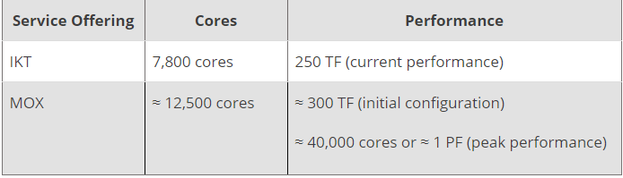
Epidemic simulation with HYAK
Hyak is part of an integrated, scalable, scientific super-computing infrastructure operated by UW-IT

Slide 39
Current Simulations
The Seattle HIV/AIDS modeling project (SHAMP)
~ 800K node simulation to represent all adults 18-45 in King County
100 years of simulation in ~ 5 days
Long simulations (50-100 years) are generally used for diagnostics and establishing epidemic equilibria
Clinically relevant time horizons:
Changing epidemic conditions
The transitions to new treatment and preventions options
Government funding cycles
Run in a fraction of the time (hours)
Simulations can be parallelize across the HYAK system
Hundreds of simulations can run simultaneously

Slide 40
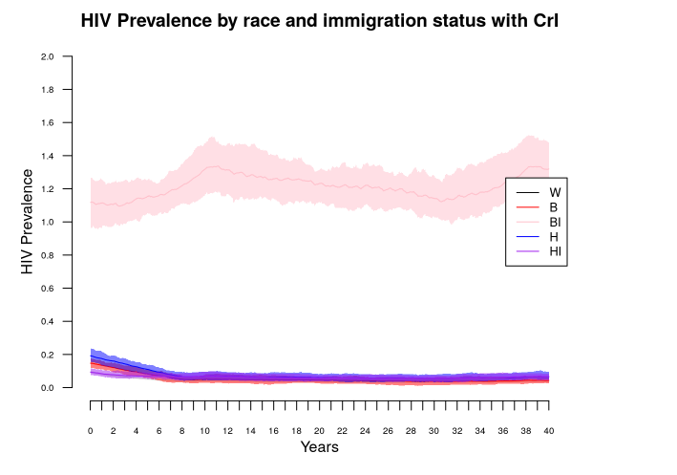
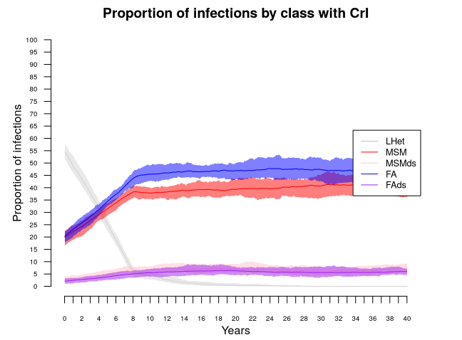
Epidemic outcomes
Incidence and prevalence
By any attribute of interest
Age
Race
Behavior profile
The entire epidemic process is known
Is R₀ > 1
Within a particular subgroup?
Risk profile at the time of infection
Transmission due to concurrency
Before or after diagnosis

Slide 41
Interventions
Epidemic outcomes in the presence of and intervention can be compared to baseline predictions
Number / Percent of infections averted
Person years on treatment / infection averted

Slide 42
Appendix

Slide 43
From another project at UW
Phylogenetic analyses of local HIV diagnoses
White
Black
B Clades predominate in the US
Non-B clades predominate in Africa and Asia
Asian
Latino
They form a distinctive cluster here,
predominantly black
Non-B

Slide 44
Herbeck & Kerani
Phylogenetic analyses of local HIV diagnoses
MSM
Heterosexual
They form a distinctive cluster here,
And predominantly heterosexual
Non-B

Slide 45
An independent empirical calibration target
Directly relevant for calibrating our most uncertain parameters – the FOI across the boundaries
Separate from HIV incidence and prevalence data
So those can be preserved for model validation

Slide 46
Interventions: PrEP
Feature/process | Source(s) | Status/comments
Uptake | WHAMP survey; 2017-2018 WHSPP surveys | Pending data collection; will start modeling with national ART-NET and/or WHSPP data
Adherence | WHAMP survey; 2017-2018 WHSPP surveys
Discontinuation | WHAMP survey; 2017-2018 WHSPP surveys
Risk compensation Change in condom use | Literature
HIV testing while on PrEP | WHAMP survey; 2017-2018 WHSPP surveys | Pending data collection; will start modeling with national ART-NET and/or WHSPP data

